Slide 1
PhD and beyond!
A friendly ramble by Paul Garrett
with lots of help by many others
Accurate as of 27/03/2019

Slide 2
Topics of Today
The road to a PhD
- Tips and tricks to make it easier
- Advice from the audience
Beyond the PhD
- Jobs you could get
- The Academic Research Path
- Interview Conversations with current Academics

Slide 3

Paul Garrett
Academic Career so far…
2012—2013 Volunteer Functional Neuroimaging Laboratory (FNL)
2013—2015 Research Assistant in the FNL
- EEG, MRI, fRMI and DTI
- Task Switching and Stop Signal Tasks
- Response time modelling of Switch Costs (Cooper, Garrett, Rennie & Karayanidis, 2015)
2016—2019 PhD in Cognitive and Mathematical Psychology (4th year now)
- Study Numerical Cognition i.e., Quantities and Numbers (Garrett, et al, 2019^{a,b} in press)
2016—2019 Other academic stuff
- Understanding memory through life logging technologies (Dennis, Yim, Garrett, Sreekumar, et al. 2019^{a,b,c,d},2018^{a,b},2017)
- Privacy vs Open Science (Dennis, Yim, Garrett, Sreekumar & Stone, 2018)
- Mathematical Designs & Tools for SFT (Garrett, Howard, Little, & Eidels, 2019^{a,b,c}, 2018)
- Making Games for EEG (Partick Cooper & Aaron Wong)

Slide 4
Paul Garrett
Other important stuff to understand who I am…
2015—2019 Mentored/Co Supervised 3 honours students to their own PhDs. Mentored 2 honours students to Masters & 2 to Clinical Registration. Mentored 4 honours students who went into Industry Work.
2017 Developed/delivered course materials for Cognitive Psychology [PSYC2300]
2017—2018 Science Communication & Community Outreach.
- Teaching the Science of Psychology to School Children (2018)
- Teaching Science Communication to Adults and Teachers (2017-2018)
- Community Seminars on the use of Mathematics in Psychology (2018)
- Hosting Psychological Science talks at University Open Days
2018 - Private Statistics Tutor for Aboriginal Students via Charles Darwin University
- Developed free How-To-Guides on understanding basic statistics & writing
2019 – Current Goal: Helping other PhD & Masters Students

Slide 5
Achievement and a PhD
We each seek to achieve something different in our PhD’s
Getting out/making money
Work/Life Balance
Teaching & Resources
Academic Careers
Work with Industry Partners
Community Outreach & Support
Helping People
We will each have different ideas on what makes achieving these goals ‘easier’. Take some time today to learn how other PhD Students have made their experience easier.
Notes:
It’s easy to get lost in the PhD Haze
Focused upon the next paper, or analysis, or lesson plan
Feeling like any time not spent working is ‘dead time’

Slide 6
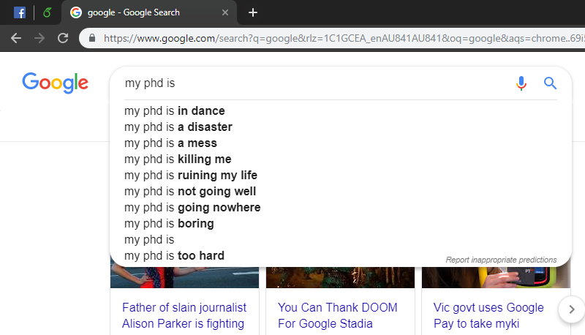
tldr?
Absent?
Gave up?

Slide 7
Making the PhD Easier
Relatively Obvious Topics
A Research Scholarship and Supportive Supervisor
A friendly and supportive work environment
A supportive family who respects your choice to do a PhD
A financially and emotionally supportive Partner.
A work/life balance (but we’ll come back to that)
If you or someone you work with doesn’t have access to these, show some understanding, and if you can, help them because…
- Friends
Notes:
It’s easy to get lost in the PhD Haze
Focused upon the next paper, or analysis, or lesson plan
Feeling like any time not spent working is ‘dead time’

Slide 8
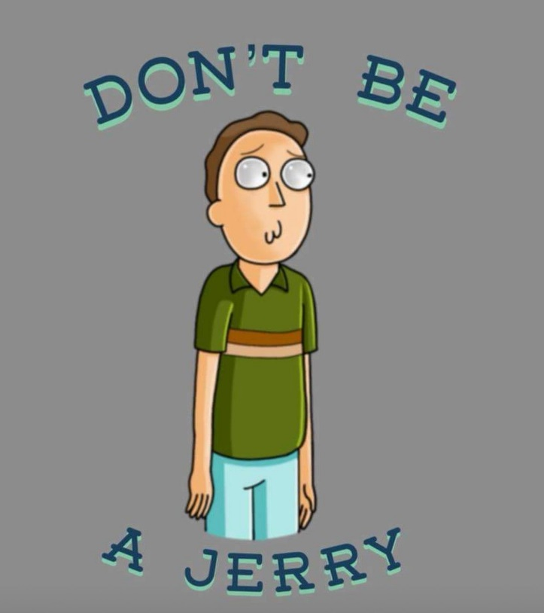
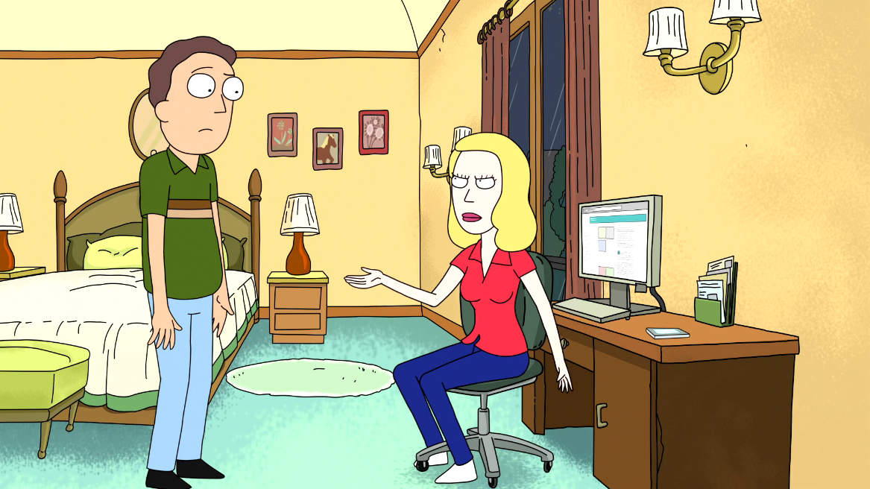
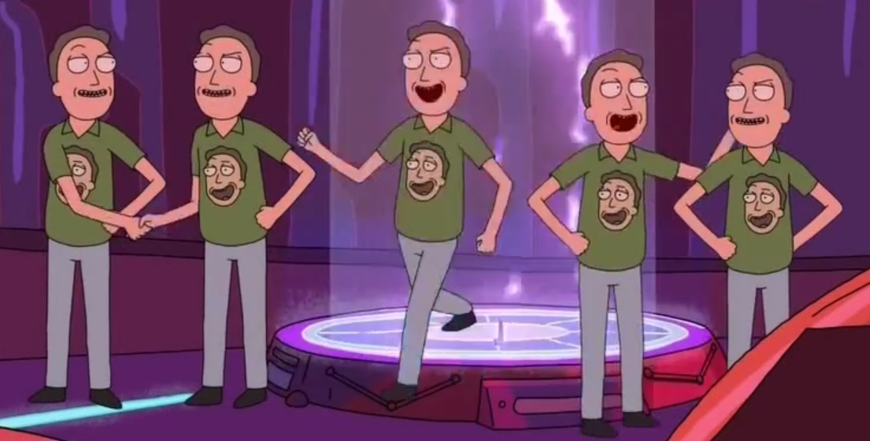
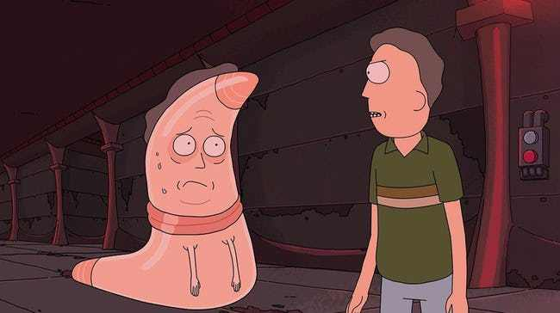
Supervision and Workstyle
The PhD is an apprenticeship in Science.
You don’t have all of the answers. You’re not meant to. So ask for help.
Imposter Syndrome is real.
Give your imposter a name. Mine, is Jerry.
When they hang around, introduce your Imposter to your friends
When you need to, tell your imposter to go away
Don’t let your imposter hold you back!
People deal with negative emotions better when discussed in the third person (Kross, 2011). Let your imposter deal with those negative emotions, so you don’t have to.
_{1.}Kross, E., & Ayduk, O. (2011). Making meaning out of negative experiences by self-distancing. Current directions in psychological science, 20(3), 187-191.
Notes:
v

Slide 9
Supervision and Workstyle
Identify your workstyle and goals. Communicate this to your Supervisor. Their job is to help you achieve these goals.
If you want to be a professional teacher, they should facilitate your move to becoming a head tutor and lecturer.
If you want to be an academic, they should facilitate your move to becoming an Early Career Researcher
If you want to go into corporate research, they should help you find industry partners who will hire you during/after the PhD
If you want to have a work/life balance, they should respect that and support you completing your PhD at your own pace.
Notes:
v

Slide 10
Supervision and Workstyle
Identify your workstyle and goals. Communicate this to your Supervisor. Their job is to help you achieve these goals.
As an example, Dr Guy Hawkins.
“I was lucky to have Scott as a supervisor. I told him my plan was to become an academic and return to Newcastle.”
“He helped me get my first Post-Doc in Sydney. Later (in Amsterdam), I received a fellowship.”
“I hadn’t spoken to Scott in years. I called, and he asked ‘Are you coming back?’ Immediately, he began helping me get a position in Newcastle. He knew what I wanted, and he always advised me on how to get there.”
Notes:
v

Slide 11
Knowing what is ‘Normal’
In the PhD ‘haze’, it’s hard to know what ‘normal’ is. So let’s go through some ways to identify a ‘normal’ experience.
Mentorship
Someone a little ahead of you e.g., Late PhD or Post-Doc
Advice on your next step and how they got there
Someone a long way ahead, but in the career you want e.g., Lecturer
Advice on your trajectory and where you should be spending your time
Someone who can ‘go into bat for you’ when you go for interviews.
Someone without investment in your current work e.g., A colleague you meet at a conference
Advice on whether your situation with you’re a) Supervisor, b) Grant applications, c) Publication record, d) Lab environment, is normal or toxic.
Notes:
v

Slide 12
Knowing what is ‘Normal’
Toxic Lab Environments
From experience, it is hard to identify a toxic lab when you’re in one. Too many students spend 4+ years experiencing bullying, sexual harassment, unreasonable workloads, only to see how bad things were in hindsight.
Alarming ‘Toxic’ Behaviours
Supervisor Gas Lighting e.g., “you should be more assertive”… “now isn’t the time to be assertive” or “you just need to try harder” but offering no advice or solutions, or “you need to change this analysis” after having changed 20 times…
Bullying & Harassment e.g., lab members who delegate blame and take no responsibility. Use threat tactics to achieve their goals. View their ‘lifestyle’ as the only valid option.
Authorship Theft e.g., being asked to write a paper, but receiving a low authorship. There are various reasons this happens, some fair. But if this happens regularly; you should be alarmed.
Data Collection e.g., forced to collect data that is not, in any way, for you.
Notes:
v

Slide 13
Knowing what is ‘Normal’
Alarming ‘Toxic’ Behaviours
Threatening Pay e.g., requiring R.As and Post-Docs to work long hours for ‘free’ or as volunteers, for previously paid work. You need to be able to openly talk about pay with your supervisor or employer. If you can not, this is a major problem.
Unethical Behaviour e.g., sleeping with students, simulating data for publication, failing to acknowledge researcher degrees of freedom, forgoing ethics applications and variations, etc.
Unwilling to support external collaborations e.g., Your supervisor should be introducing you to potential employees and collaborators.
You should be trying to publish separately from your Supervisor(s). This shows academic independence and collaboration on a CV.
You should be sent to different labs as part of your PhD e.g., USA, EU, Canada, NZ.
Notes:
v

Slide 14
Knowing what is ‘Normal’
Alarming ‘Toxic’ Behaviours
Seek Outside Advice e.g., talk to previous lab members or describe your lab experience to other students or academics. This can be awkward, but you should get a sense of whether the activities are ‘normal’ or ‘toxic’
Respecting Work/Life Balance. We each work differently. Sometimes, we need to meet difficult deadlines e.g., submissions, and work unreasonable hours. But personal hours are not work hours. If you feel:
Pressured to work unreasonable hours, just to meet daily/weekly goals.
Unable to celebrate your achievements or take time after meeting a deadline.
Feel anxious when asking for time off your PhD to, for example, get married, be with family, go to the doctors, or pick up your children.
…then you might be in a toxic lab space.
Notes:
v

Slide 15
Knowing what is ‘Normal’
Alarming ‘Toxic’ Behaviours
“If you ask a student, ‘how is your Supervisor?’ And they do not immediately respond with ‘Great!’ Ask yourself why, and find another supervisor.”
– Scott Brown, Deputy Head of School. UoN.
What Can You Do?
In extreme cases, you can go to the Dean of Graduate Research, the Dean of Students or Deputy Head of School and ask for help. They will:
Interview you,
Formally intervene on your behalf and mediate discussions between you and your supervisor,
Help you change supervisors if you wish.
But often, that’s not what you want to do. Instead, you want to change your lab environment. Here’s how we changed ours at Newcastle.
Notes:
v

Slide 16
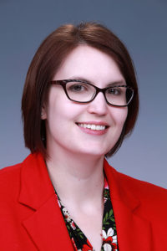
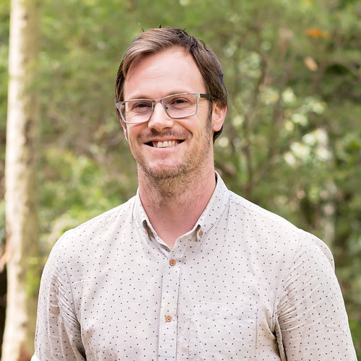
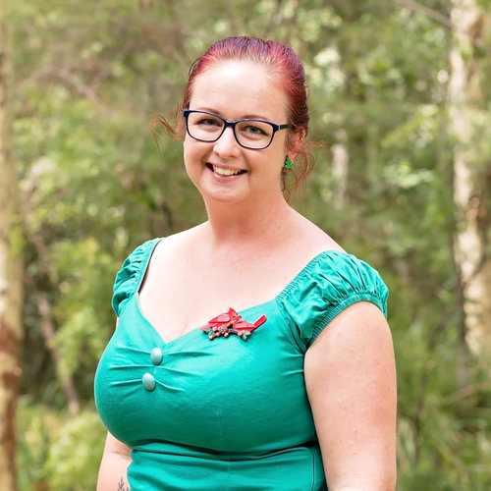
Making a Supportive Lab Environment
“I don’t want to go home, this lab is great!”
- Dr Leslie Blaha, Chief Scientist, Analysis in Motion
“I’ve never worked in a better lab.”
- Dr Rob Taylor, Post-Doc Fellow UoN
“It’s hard to say just how good a lab we have here.”
- Dr Emily Freeman, UoN
Notes:
v

Slide 17
Making a Supportive Lab Environment
Supportive Labs
Make you want to come to work
Foster student-to-student mentorship and research development
Between PhD and Honors Students, and among PhD Students
Encourage community outreach
It’s fun, rewarding and builds your social media and public presentations
Provide opportunities to take on additional responsibilities e.g., running a journal club, teaching a specific skill like coding or LaTeX editing, running social media accounts
This is important for institutes looking for ‘what else’ you bring to the job
Invite external academics to present and teach the students
Provide opportunity for students to host events e.g., small-scale movie nights, or large-scale Post-Graduate Conferences
Event organization is an important skill. Displaying this is hard, look for oppertunities.
Notes:
v

Slide 18
Identify the Keys to Support
Activities should be Motivating, Accountable and Rewarding.
A PhD is a long-term reward. This is hard to motivate.
Small, achievable goals are motivating.
Making goals communal ensures you are accountable to your peers.
This means a ‘check list’ on a lab wall or on Slack.
The PhD isn’t everything. Set goals outside of academia too
E.g., Run 3Km, learn some music or make some art
Hitting your goals is internally rewarding, but external rewards are important too! e.g., the Great Coffee Scheme!

Slide 19
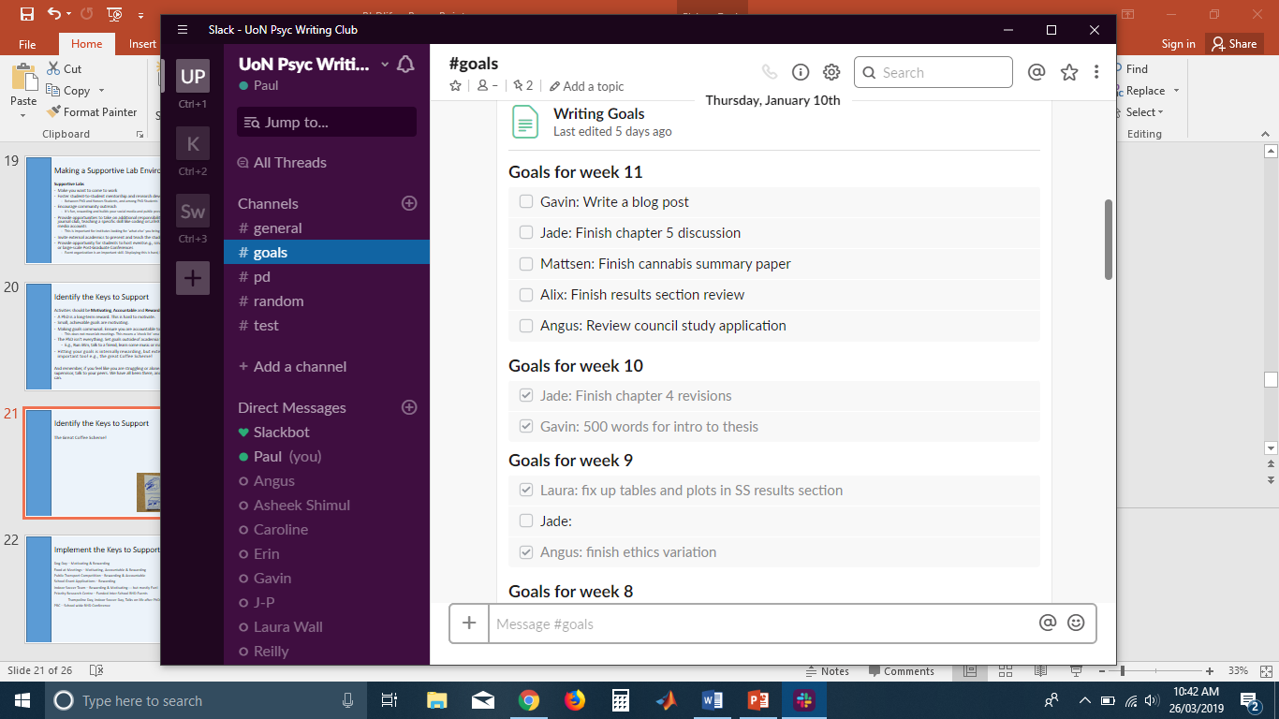
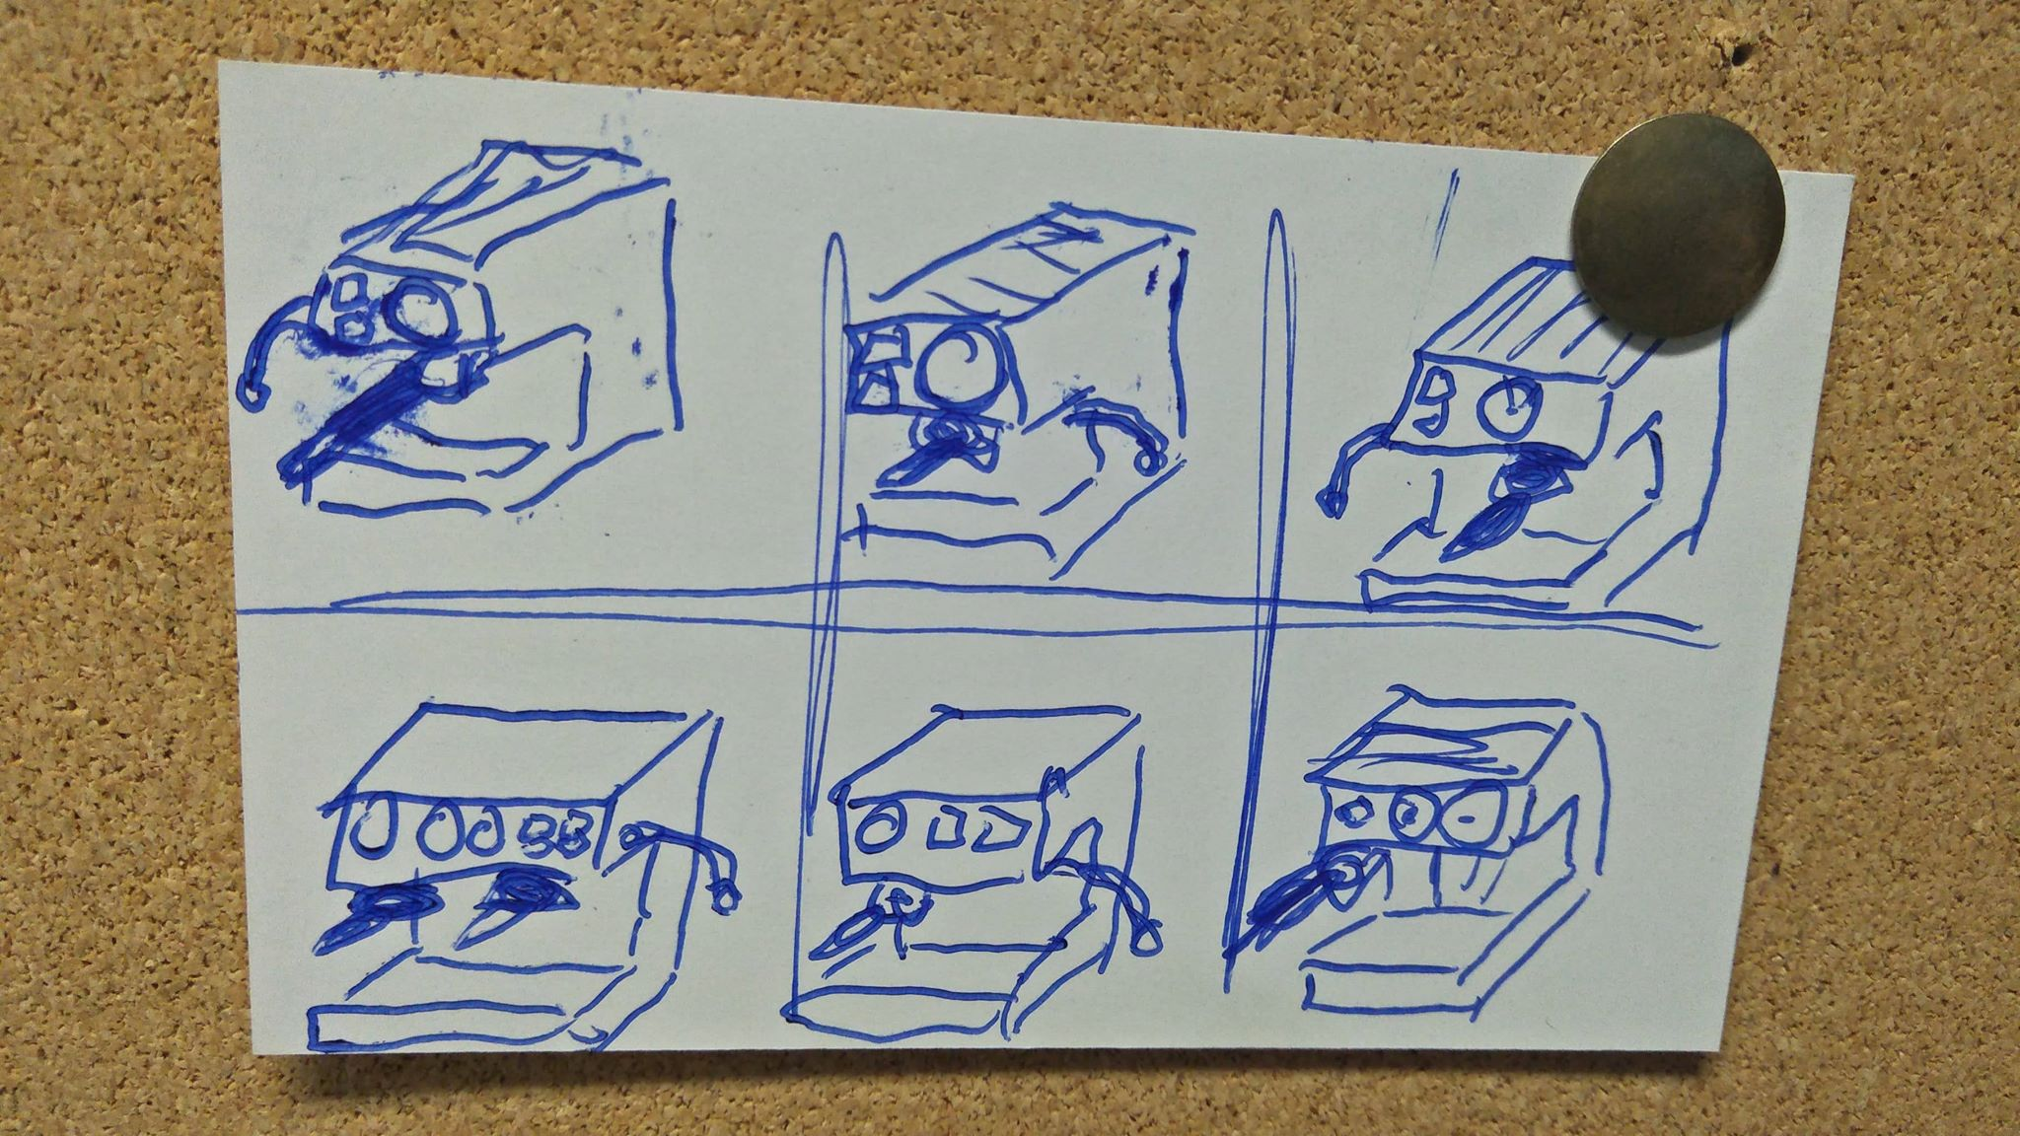
The Great Coffee Scheme!
Motivating, Accountable,
Rewarding!
One Goal : One Tick
Six Weeks = Free Coffee
Supervisor Cost to Writing = $5 per 6 Weeks

Slide 20
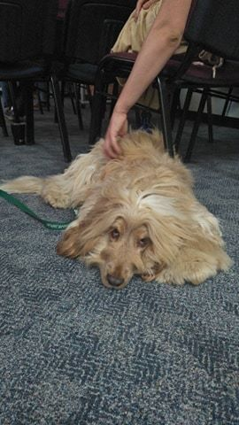
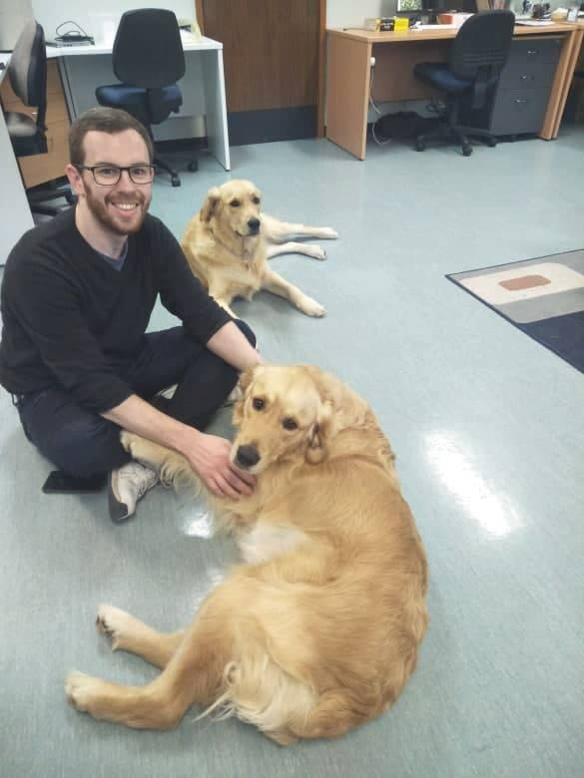
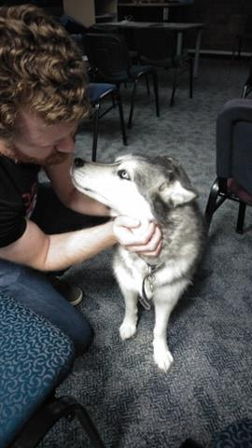
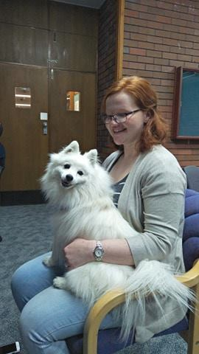
Dog Days!
Motivating & Rewarding!

Slide 21
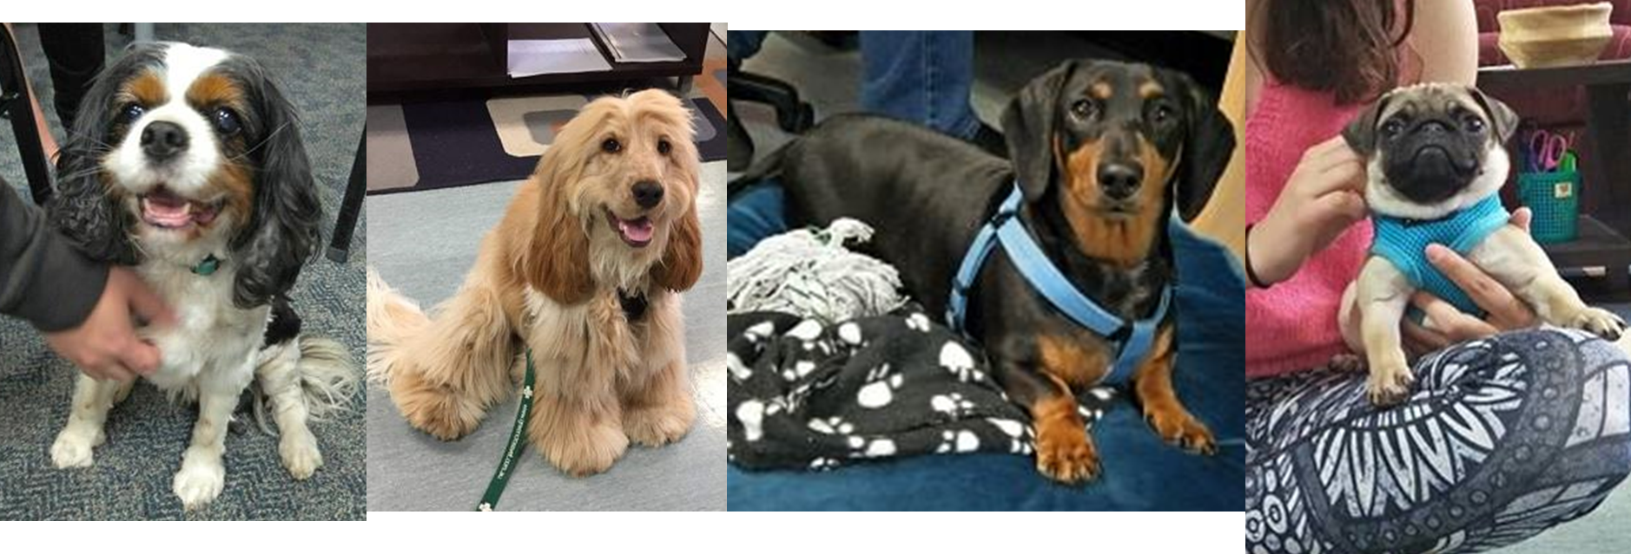
More Dog Days!
Motivating & Rewarding!

Slide 22
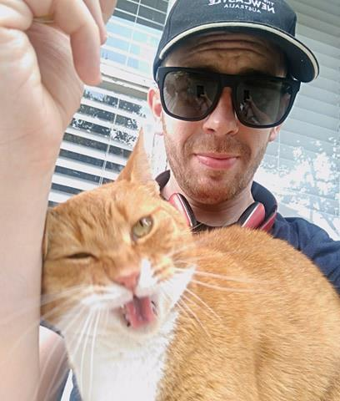
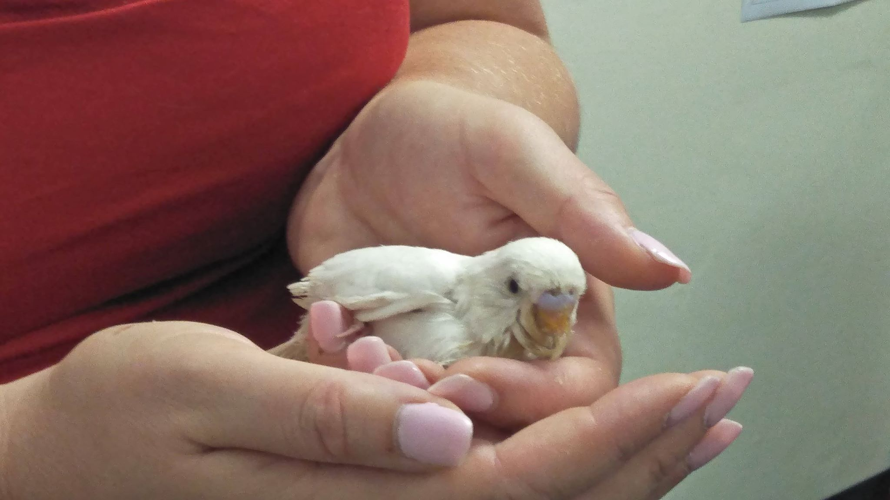
Don’t have a dog? Birb and Cat Days!
Motivating & Rewarding!

Slide 23
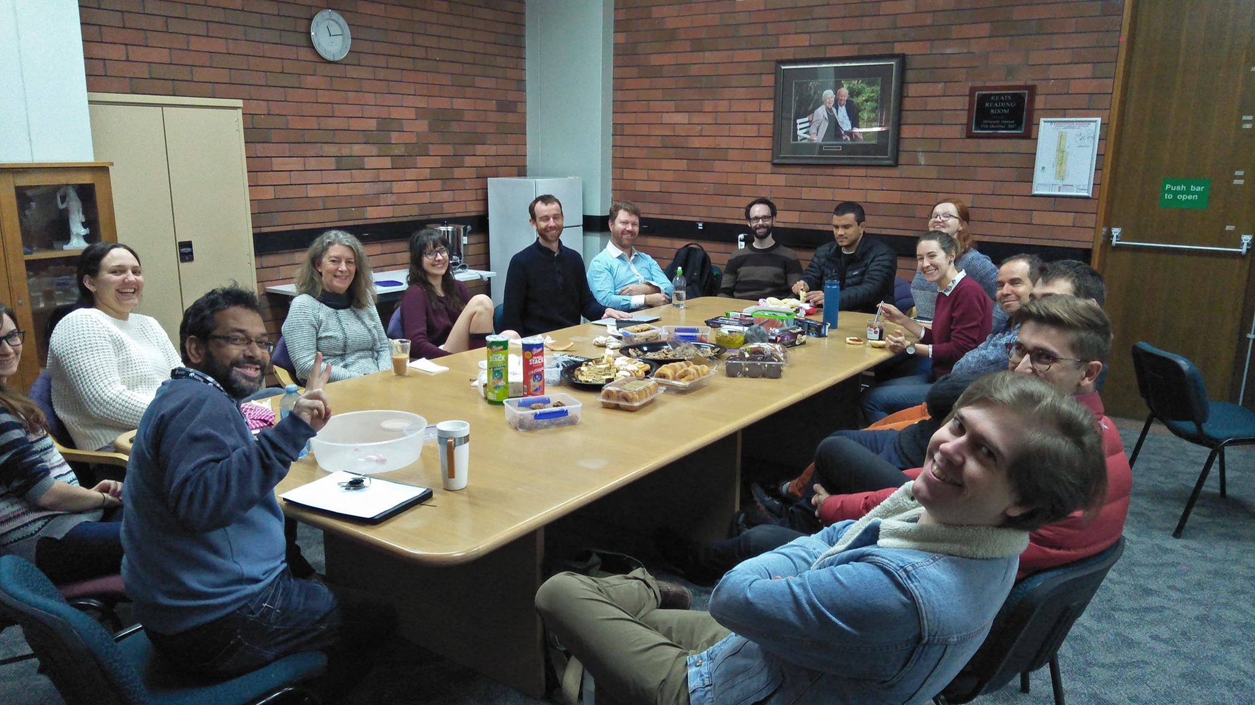
Food at Meetings!
Accountable & Rewarding!

Slide 24
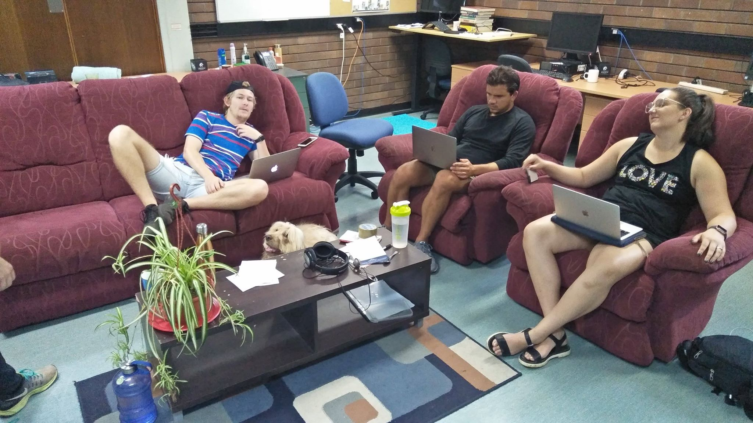
Communal Space!
Accountable & Rewarding!

Slide 25
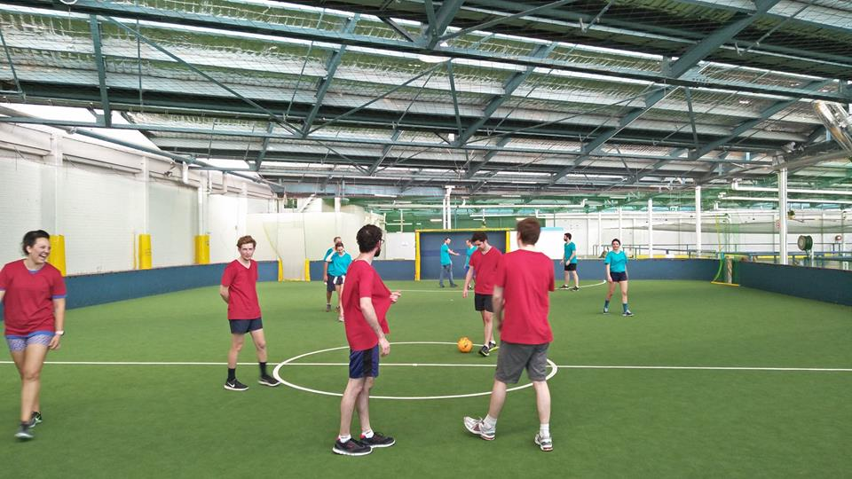
Lab Soccer Team!
Accountable, Rewarding,
Non-Academic Fun!

Slide 26
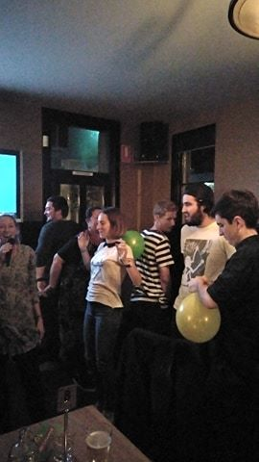
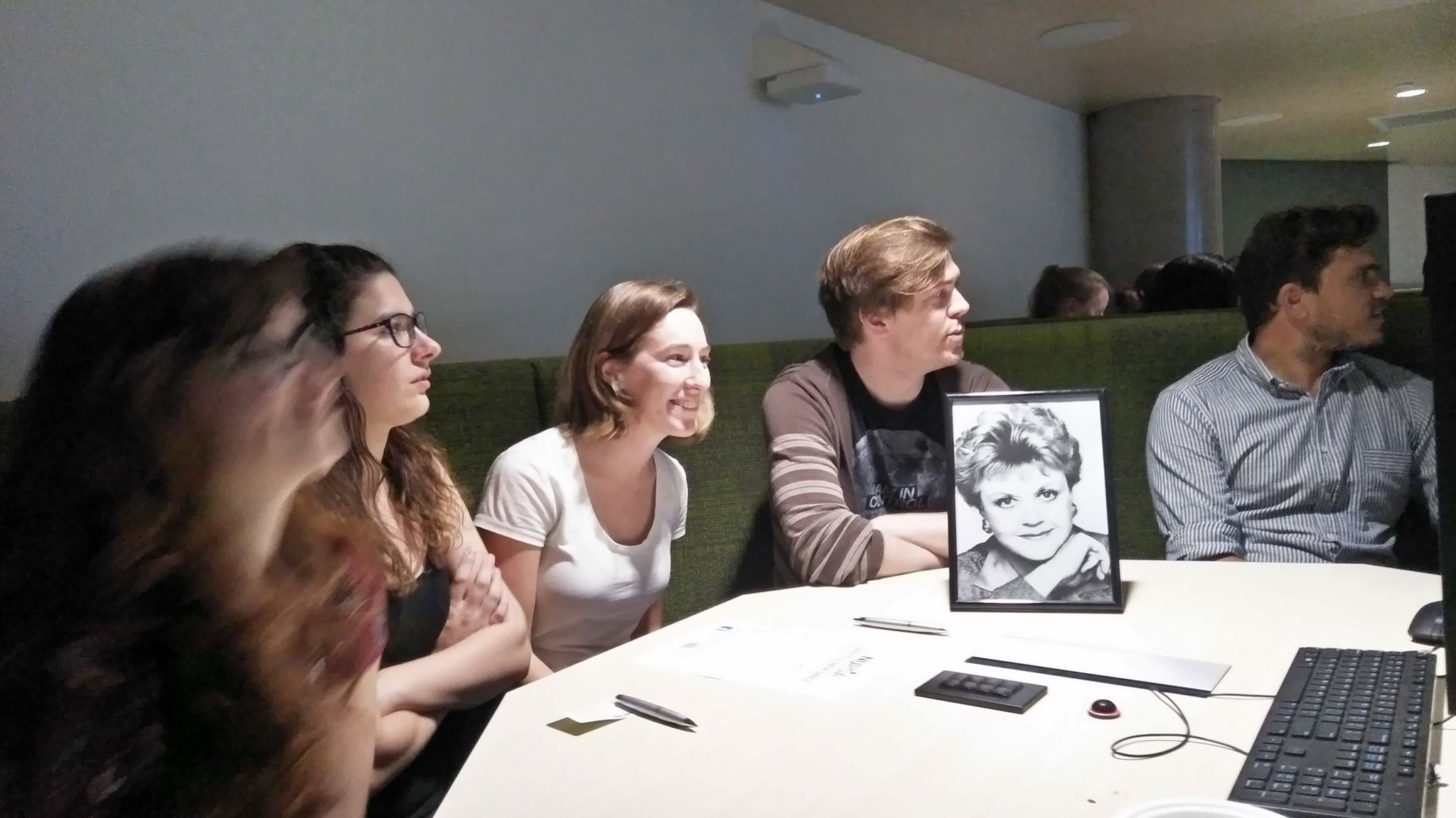
Lab Trivia Team!
Accountable, Rewarding,
Semi-Academic Fun!

Slide 27
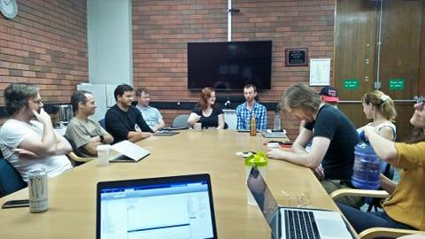
Journal Club!
Accountable & Arguably Rewarding

Slide 28
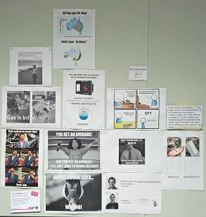
Lab Meme Wall!
Rewarding
And Fun!

Slide 30
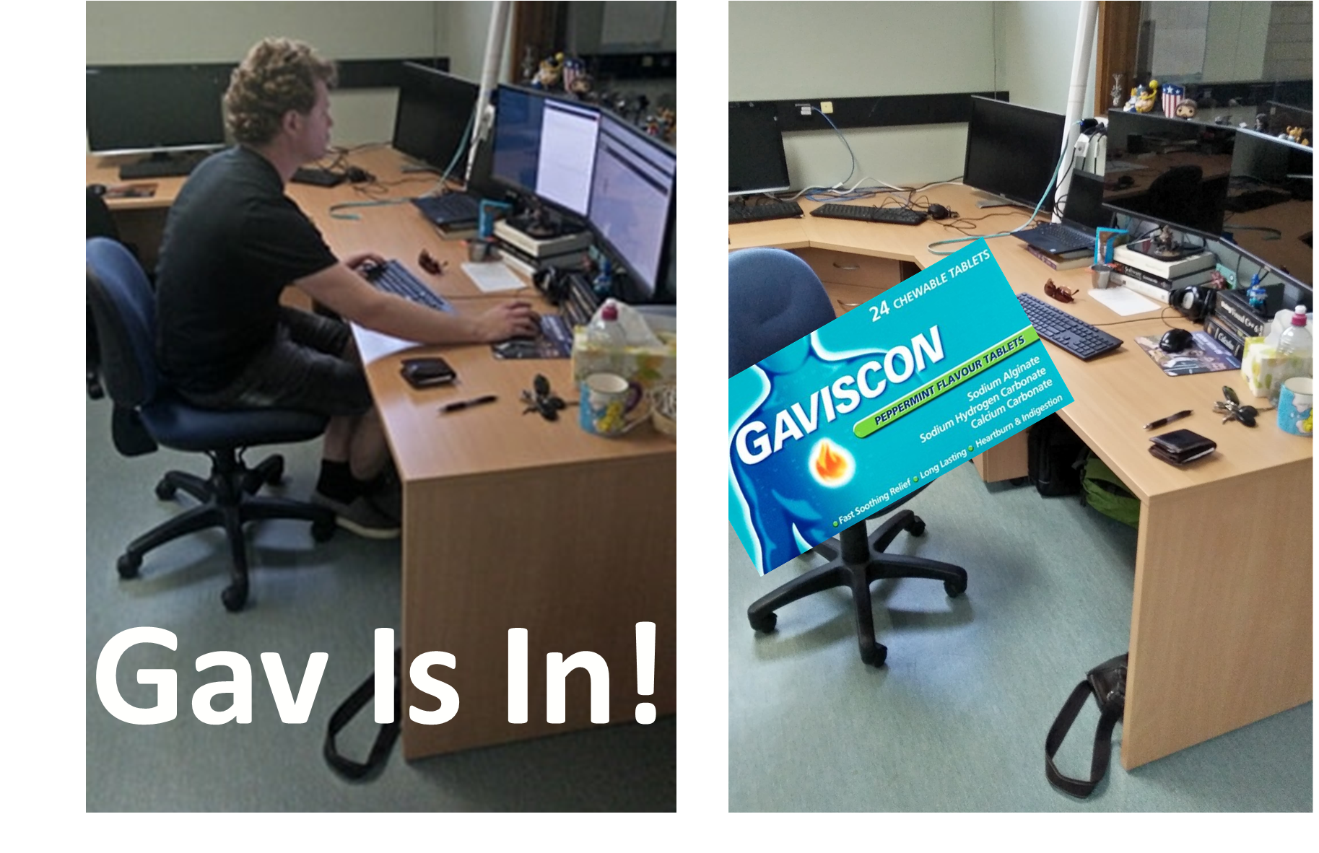

Slide 31
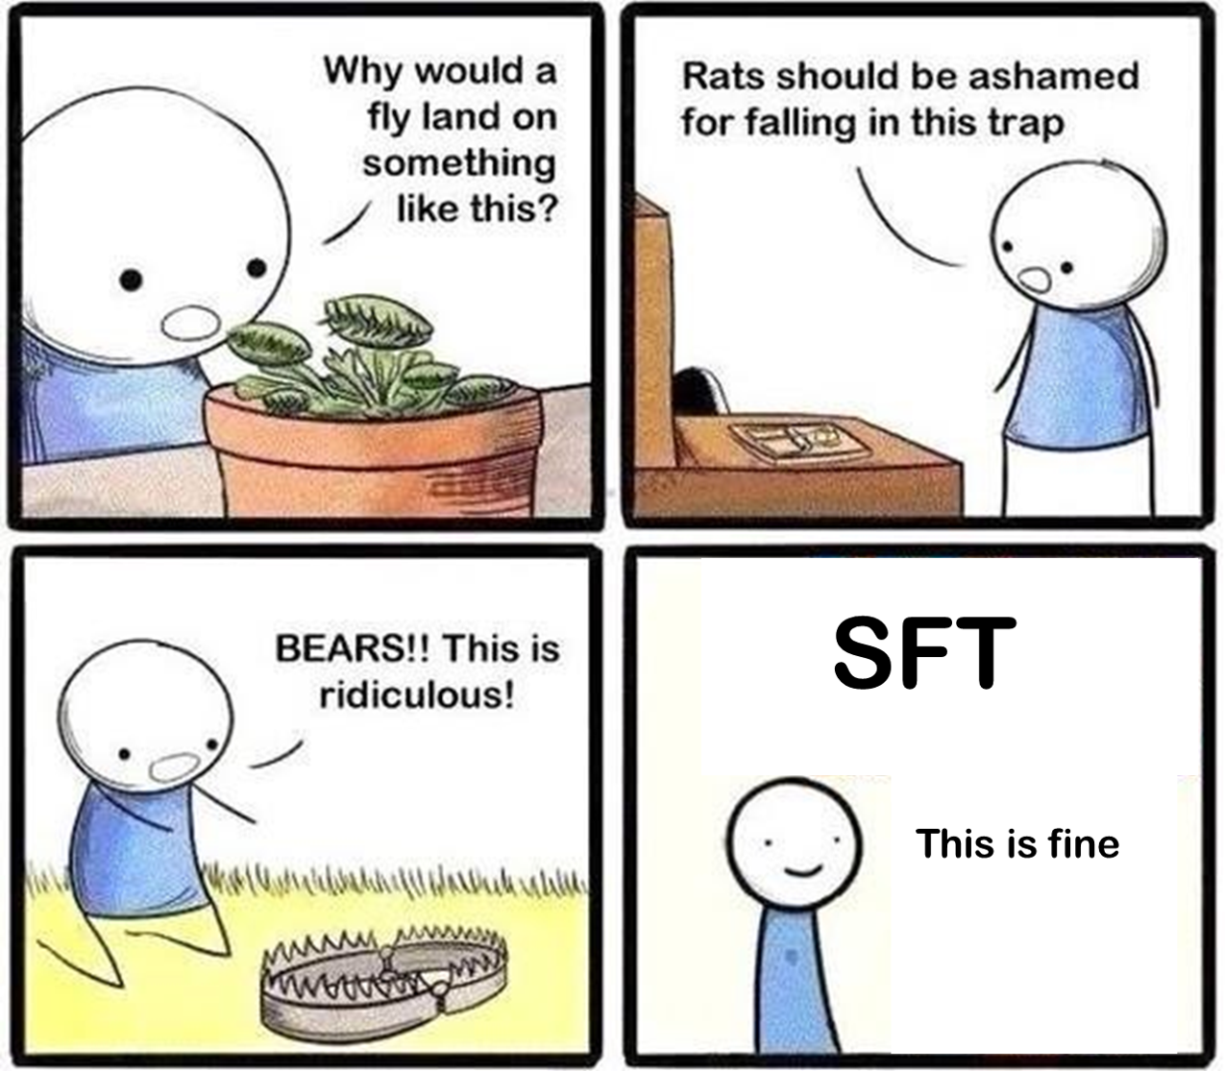
PhD

Slide 32
Professional Development Club!
Accountable, Motivating
& Rewarding
Set Professional Development Goals and hold one another accountable. We meet 1hr Each Week to:
Contact Collaborators
Set Up RSS Feeds
Build CVs
Apply for Grants
Apply for Jobs
Set up a Social Media Presence
Apply or Complete Short Courses
Organize our calendars
Organize our Workflow
Learn Coding: R, Java Script, Python & Matlab
Setup OSF
Backup Our Work (B.Y.S.U)
Learn ‘How to Write’
Make a Job Skills List
We use the Pomodoro Method (25:5:25:5)

Slide 33
Writing Club!
Accountable, Motivating
& Rewarding
Set Writing Goals and hold one another accountable. We meet 1hr Each Week to:
Write sections of papers
Have guests discuss writing techniques
Critique Well written, and poorly written papers
Read each others work
Key Writing Lessons
Write a little, regularly
‘Park on the Hill’
Writing ≠ Editing
Be accountable
Invest in grammar
Be Brief: Rule of 3s
Topic & Linkage Sentences

Slide 34
Implement the Keys to Support
And remember, if you feel like you are struggling or alone.
Talk to your supervisor.
Talk to your peers.
Set small goals.
Achieve.
Many of us have been there, some will again.
We will help you however we can.

Slide 35
How to say “No”
Often, we feel obliged to say ‘Yes’ to every opportunity that comes our way.
Teach a new course? – Yes
Take on a new project? – Yes
Apply for a new grant? – Yes
Take a Post-Doc position? – Yes
Take on a new mentorship? – Yes
This ‘Yes’ lifestyle opens many doors; but comes at a cost to time, stress, and committeemen. So when and how should you say ‘No’?

Slide 36
How to say “No”
Say you will ‘think about it’, and get back to them later. This lets you truly consider your options, even if you really want to say yes, and relives the pressure to make a decision on the spot.
Inevitably, you will always have too much work. That is a PhD. Rather than ask yourself “can I do this?” Instead ask “what am I willing to give up so I can do this?” If there is nothing you are willing to give up, than say no, confident in having made the right choice.

Slide 37
How to say “No” to your Supervisor
Sometimes “No” doesn’t seem like an option e.g., Supervisor
If so, try a different tactic and remind your supervisor that you have too much work.
Rather than say “No”, ask “Ok, what project should I put on hold to do this? Task A, B or C?”
This is a gentle reminder of the tasks you have to do, and that something will need to be benched to deal with the added workload. If your supervisor is wise, they will suggest you drop something or delegate the work elsewhere.

Slide 38
How to say “No” to your Supervisor
The Non-Linear Progression of Research Time
Be comfortable with not being busy. If you are flat out all of the time, you are only dealing with short-term problems.

Slide 39
You have a PhD!
Now what?
A friendly ramble by Paul Garrett,
About interviews he conducted.
With thanks to
Dr Emily Freeman, Dr Robert Taylor,
Dr Guy Hawkins, Dr Patrick Cooper,
A. Prof Ami Eidels

Slide 40
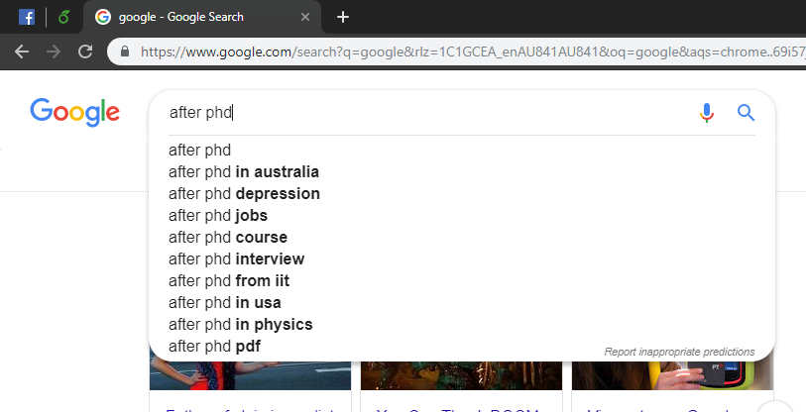

Slide 41
Now what?
Research
Academia (University), Not for profits, Research Institutes
Critical thinking, Grant/Paper writing, Project Management, Exp Design
Government Agencies
State & Federal Agencies
Policy Development (Universities & Corporations also employ for this)
Australian Secret Intelligence Service (ASIS)
Population Health
Teaching
Colleges & Universities (in Australia or overseas)
Scientific Communication
Government Funded agencies (CSIRO), Journals, Uni’s, & Social Media Outlets
Industry, Private Corporations, Think Tanks & Self-Employment
Research & Development, Critical thinking, & Education are highly valued. More on that later.
Notes:
PhD is learning how to learn. You can apply those abilities anywhere. They encourage self motivation, creativity and perserviance

Slide 42
Industry Science Levels
Industry Research Levels (very broadly)
Analysist
<=$70K
Snr Analysist (PhD Entry level, typically).
$70 — $90K
Scientist (Assistant level)
>$90 – $130K
Research Scientist (Independent Researcher – similar to Grant Holding Academic)
>$110K – $160K
Head of Science (Executive level)
>$150+
But also…
Any corporate position that you apply for and move into from any of these other roles.

Slide 43
The Academic
Research Path

Slide 44
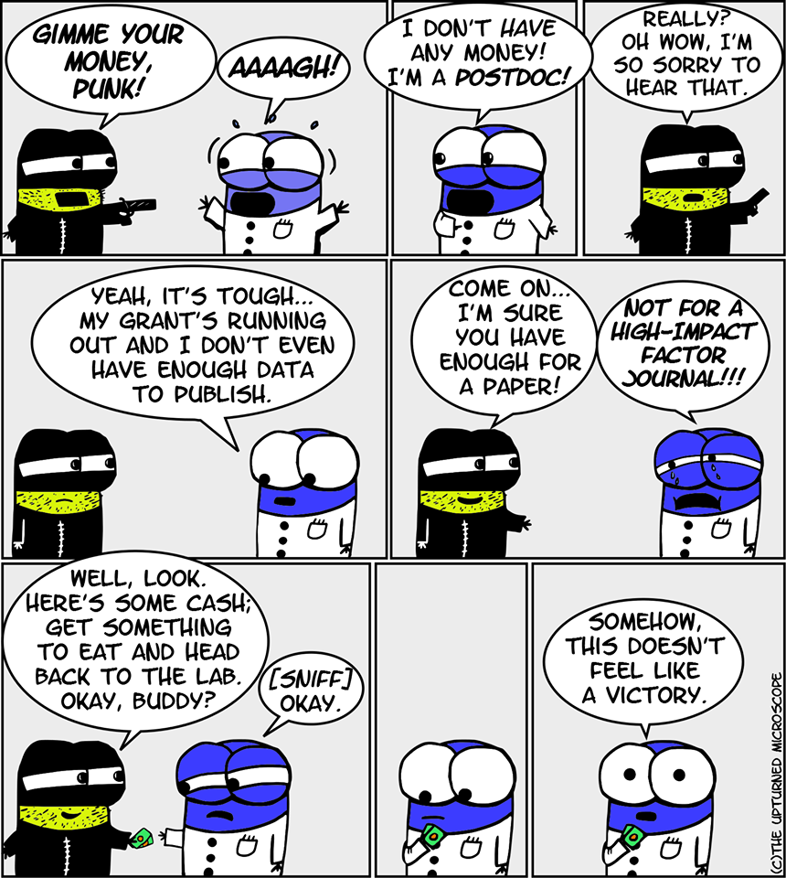

Slide 45
Academic Research Path
When should I take a Post-Doc?
This is a personal question, but here are some guide lines
Do you need the money, if so, ASAP
The Process is Haphazard – Reliant upon Grants being released
Start making friends at higher levels and letting them know you’re interested
Ask who they think you should think to
Can you start without submitting your PhD?
Typically, this greatly delays your PhD submission.
You may be paid at a far lower rate, as you are not a Doctor yet. If you cannot work on your PhD Thesis, this is a massive problem.
But this is not always the case, and you may be paid at full rates
Starting a Post-Doc before submission gives you time to build you research profile BEFORE officially starting your time as an Early Career Researcher.

Slide 46
Academic Research Path
When should I take a Post-Doc?
When you are ready.
If you need time off after your PhD, or want time off before you submit and wish to continue in Academia, consider delaying your submission.
You may not have a strong academic profile or skills by the end of your PhD
Research might be exploratory and result in no publications
Your work might encounter problems e.g., animals dying, data loss, etc.
You may wish to gain grant funding early to help future applications
You may wish to gain some more skills before leaving your PhD
If so, you may wish to delay submission. Work as an R.A., work as a private or University tutor, get a pre-submission Post-Doc and build your profile.
Consider these options if you wish to maximise your time as an Early Career Researcher.

Slide 47
Academic Research Path
What should I look for in a Post-Doc Position?
Some useful guidelines from Academics
A project that is not entirely exploratory (Emily Freeman).
Exploration is good, but risks your chance at publishing if nothing is found or if things take too long. You might only have 1 Year.
You need publications to apply for a Fellowship, so save exploration for a Fellowship Project e.g., a Discovery Grant.
A full lab, with lots of smart and well rounded Academics
The people you work with inform you practices, your philosophy on teaching and science. Make sure they’re good academics, and good people (Emily)
Mentors. People who will teach you skills for your career (Ami Eidels)
Technical skills you didn’t get in your PhD (Robert Taylor)
Be strategic about the jobs you take on to get skills out of them. It’s still a job.

Slide 48
Academic Research Path
What should I look for in a Post-Doc Position?
Happy PhD & Post Doc Students
Look into how long past Post-Doc students have lasted in the lab & talk to the current students (Patrick Cooper)
Work/Life Balance
Unlike the PhD, you’re work is for someone else. In no uncertain terms, your Post-Doc is a job. Treat it like one. (Guy Hawkins)
Overseas Opportunities
Graduates will average 2—3 Post-Doc positions, each contract typically lasting 1—2 years (Robert Taylor)
Experience in overseas labs is looked on very favourably when going for fellowships or promotions. Consider this. (Simon Dennis)

Slide 49
Academic Research Path
America vs Australia vs European vs Chinese Post-Docs
American Post Doc Positions (Emily Freeman, Ami Eidels)
Typically lower-paying (equivalent of $60’000--$80’000 AU)
Health Insurance may come with the Job
Requires working VISA for partners (marriage makes it easier)
Work in very big Prestigious labs w/ highly respected Academics
Typical role is that of lab manager & paper writer. Minimal PI interaction.
Numerous Opportunities (due to low cost)
Australian Post-Doc Positions (Robert Taylor, Patrick Cooper)
High paying ($85’000+)
Focused on Writing Papers (maybe lab management)
Medicare
Very few opportunities relative to USA

Slide 50
Academic Research Path
America vs Australia vs European vs Chinese Post-Docs
European Post-Doc Positions (Guy Hawkins)
Expensive to host, but may be paid less than Australians
Health Care comes with position
Lots of opportunity to travel & go to numerous large conferences
May include overseas moving allowance & family benefits
More Post-Doc opportunities than in Australia, but fewer than in the USA
Chinese Post-Doc Positions (David Elliot)
Many positions, but at small universities (i.e., you alone might be the psychology department). And of course, there are Large Universities too.
Very well paid ($85’000 – 100’000+)
Seeking English Speaking academics
Family & Health Care benefits unknown. In the process of figuring this out.

Slide 51
I have a Post-Doc, what next?
Early Career Researcher (ECR; 5 Years Post PhD)
Get Post-Doc or Lecturer Position & Work for Someone Else. It’s a Job.
Positions usually last 1—2 Years.
The aim is to get skills to further your career in Academia.
Focused on Research. Ideally, 70:10:20, Research : Teaching : Administration
Teaching component is generally student supervision
May apply for ECR Specific fellowships/grants
Discovery Early Career Research Award – DECRA. Up to 5yrs.
National Health and Medical Research Council – NHMRC. Up to 5yrs.
Marie Sklodowska-Curie Research Fellowship – 2 Years in Europe.
Australian-American Fulbright Commission, Post-Doc - 3—10 Months
Others Found Here

Slide 52
I have a Post-Doc, what next?
Research Fellow (Usually 3—5 Years Post PhD within ECR time)
- Gain Research Grant e.g., DECRA, NHMRC
- Conduct Independent Research with minimal teaching load
- The fellowship pays most of your salary. A University tops off the rest
- Focused on Research. Ideally, 70:10:20, Research : Teaching : Administration
- Once this ends, you can either
- Go onto a continuous Contract
- Go onto a short-term teaching contract
- Leave that university for work else where
It’s about here we should become familiar with the University Levels…

Slide 53
Academic Research Path
University Contract Levels (University of Newcastle, 2017—2018)
Level A – Assistant Lecturer (8 Yearly Steps)
Pay Bracket $66’748 — $90’582
PhD Starts at Step 6 — $84’385
Level B – Lecturer (6 Yearly Steps)
Pay Bracket $95’351 — $113’23
Level C – Senior Lecturer (6 Yearly Steps)
Pay Bracket $116’805 — $134’686
Level D – Associate Professor (4 Yearly Steps)
Pay Bracket $140’644 — $154’943
Level E – Professor (Single Pay Level)
Pay $181’170
Level A → Level B requires a Promotion
This means hitting your Level’s
Key Performance Indicators (KPIs) & Applying for the role.
e.g., Hours worked at….
Supervising Students
Teaching
Outreach
Papers Published
Administration
The hours allotted to each task change, depending on your Level. E.g., Level A publication hours per paper may be less than Level B, as Level B should be ‘faster with more experience’. But, Level A is expected to publish fewer papers than Level B

Slide 54
I have a Post-Doc, what next?
Mid Career Researcher (+5yrs Post PhD, >10yrs to Retirement)
- Typically defined as aiming for Level D or E positions (A.Prof & Prof)
- Compete with other professional Academics for grant funding
- 40:40:20, Research : Teaching : Administration
- Benefit to the Institute – Committee Participation & Outreach are very important
- The University Pays Your Salary. Grants my contribute (pay better).
- Grants: Linkage Grants, military grants, ARC, NHMRC, Future Fellowship awards, Australian Research Fellowship, Australian Professional Fellowship.
- Grants also give you PhD Scholarships, Post-Doc Students, Equipment/Travel Funds
Late Career Researcher (A.Prof, Prof or <10yrs to Retirement)
- Have your own Lab & compete for very large grants
- Apply your experience to help grant committee selections e.g., ARC, DECRA
- Equivalent to getting Tenure in America

Slide 55
Interviews with current academics (UoN)
Robert Taylor
- Post-Doc, ECR, Level A. 4 Years Post PhD (delayed submission).
Emily Freeman
Independent Researcher, ECR, Level B. 11 Years Post PhD.
ECR at UoN due to short-term contracts; not ECR when apply for Grants
Guy Hawkins
Research Fellow, DECRA, ECR, Level A.
Ami Eidels
- Associate Prof. Level D.

Slide 56
Short Term Contracts (1 Year)
“Universities are moving to shorter term contracts, … this is negatively affecting the academic staff” – Emily Freeman
Prevent supervision. Contract must extend > end of candidature
Problems getting a mortgage (owning a house)
Highest income earner in family. High end of year stress. Unknown job prospects.
Unable to control projects – can never be a primary supervisor.
Ineligible to apply for end of year grants – no certainty of being around the next year
Spend all of your time teaching and coordinating courses. No time for research.
Short-term contract = no workload points (KPIs). Therefore, harder to apply for promotions.
“One year teaching + research, is the same as one year of research, when applying for ECR Grants. Be aware of this. One year working in a pub, that doesn’t count.” – Guy Hawkins
“Short term contracts pay well, and are fine if you are traveling and working. But they become difficult after a while.” – Guy Hawkins

Slide 57
The Two Body Problem
Moving for Academic Work with a partner (and children)
“Three things can happen. You can go overseas & your partner cannot. They move with you and sacrifice to benefit you, or you stay and your career doesn’t progress like it would if you had moved.” – Robert Taylor “We had been dating for six months when I was offered a Post-Doc in the States. He needed a working VISA, we needed to get married. We had a six week engagement, and are still married today.” – Emily Freeman “I met my partner in Sydney, she is in Finance. She said she’d come with me, if I moved to a financial hub. I moved to Cambridge, and she worked in London. It was an easy sell; the harder sell was moving back!” – Rob Taylor “My partner was very flexible. She got along in ways I never could have…She was a vet, and I was lucky. As my Grandmother said, Marry well!” – Ami Eidels

Slide 58
Finance
Is Academia financially worth while?
“In Australia, yes. In Europe, no…” “When I went to Cambridge, I was on 80K (in Australia), but when I took that job, I was on 32’000 pounds ($58’000 AUD). That’s not true of all institutes, Cambridge had the prestige to do this.” – Robert Taylor
“I am not on call and I always have flexible hours…” “I took a pay cut returning to Australia…my daughter drives coal trucks as an apprentice and was getting paid more than I was…Now I’m level B and it is financially worthwhile.”
“Your jobs are dependant upon available funding. You have to jump around a lot and go where the money is. They (academics) will do everything they can to ensure you are paid appropriately. But that means taking hits in pay, or hours, or working for multiple people. They say this makes you look ‘more rounded’.” – Robert Taylor

Slide 59
Who, What or Where?
Is it who you know, what you know or where you are at the time? The answer to these questions changes at each stage of your career.
Emily Freeman
“Who you know, then where you are, than what you know”
“Being told not to apply for a position because it was earmarked for another academic”
“Having someone to go in to bat for you with the PVC, declaring that you need to be given a continuous contract, matters. If you lack support, you may progress, but slowly.”
“When you join a lab, integrate other people’s ideas; their approach to science, their methodology, their way of marketing their research or being topical. This is hugely important for a number of reasons, their prestige rubs off on you making you look better at conferences or for publications, their methods make you a better scientist, their ability to make quick, clear and topical studies makes you more attractive and publish better, faster and with higher impact factors. Where you are matters.”

Slide 60
Who, What or Where?
Is it who you know, what you know or where you are at the time? The answer to these questions changes at each stage of your career.
Emily Freeman
“Where you are also matters for getting jobs or post-docs. If you are available for a post-doc, if you have skills and the person hiring knows it, if you can start now and maximise the Grant Funding that PI has, you are the obvious choice. But, you have to make sure the person knows it. You need to be able to say, ‘Hi Academic, do you have a post doc position available in the near future, because I would very much like to work with you?” Once they know, then you are on their radar, and when they have a position available, you might just get first preference.”
“Last is what you know. Unless you are the 1 in 10’000, who can do such high impact research that every university wants to hire you and everyone wants to work with you; what you know matters least. “

Slide 61
Who, What or Where?
Is it who you know, what you know or where you are at the time? The answer to these questions changes at each stage of your career.
Guy Hawkins
“For getting a job, it’s who you know. For keeping your job, it’s what you know.” “When going for a promotion, it’s what leverage you have.”
Robert Taylor
“It’s what you know, then who you know. I got my Cambridge position because I knew Bayes and impressed my Supervisor. But I got my Sydney Post-Doc because I literally emailed Chris and asked to work for him. He hired me as an R.A., and then a Post-Doc.”
Ami Eidels
“It’s all of them, at different points in your career.”
Simon Lilburn
“Make sure they are not a total psycho. Find a balance between research, person & style”.

Slide 62
Mentorship
What role did mentorship play in your career?
Emily Freeman “Not enough. I had one person above me and she wasn’t in a senior enough position to give me the advice that I really needed for long term planning…it is one of the biggest problems for women in STEM.”
Rob Taylor
“I started my PhD in a lab with only me and my Supervisor. I moved to Sydney to work for Chris Donkin. Chris changed my life, so everything.”
Guy Hawkins “I was lucky to have Scott as a supervisor. I told him my plan was to become an academic and return to Newcastle…he began helping me get a position in Newcastle. He knew what I wanted, and he always advised me on how to get there.”

Slide 63
The “Yes” lifestyle
At your career level, do you still feel the need to say “yes” to every opportunity?
Emily – “For the first time, no. Now that I have a continuous contract, I feel that I can start saying no”.
Rob – “Yeah for sure. Imposter syndrome is real, and I really feel it. But I just keep saying yes and trying to be better and more valuable to the Uni.”
Guy – “No, but I feel like if I want to keep progressing I have to.”
Ami – “My commitments are different now. I have 13 students, I don’t say yes to every opportunity, but I do have to say yes to each one of them. ‘Will you look at my thesis? Will you review my paper? Will you attend this meeting?’ It’s a different kind of yes.”
Simon – “You can say yes to things if you get an interesting skill out of it. People in academia will often exploit you if you open up, but, there are things to get out of this. Papers, skills, and re-orienting your career…Academic progress are non-linear on projects done. Nothing happens, then everything happens at once. You’ll say yes when you’re not busy, but then everyone wants them tomorrow! It is fine to not be constantly flat out all of the time.”

Slide 64
Normality
Do you think your experience was normal?
Emily Freeman – Yes
Guy Hawkins – Yes
Ami Eidels – Yes
Robert Taylor – “My experience was my experience. I don’t know how relatively normal it was to others. It was a fluke.”
Were these experiences the same?
No.
There are many ways to a career in academia. Every academic has a different story. If you want the academic life, believe in yourself, take the opportunities you can, and ask those above you how they made it.

Slide 65
Other comments
Is there anything you wish you could tell current PhD students?
Jobs
“It’s a tricky balance between supervisor and student, in what you convey. It’s a balance between knowing it’s hard to get a job in academia, and not being deceitful to keep your students motivated…We (supervisors) need to be better trained to teach about these things (jobs outside of academia).” – Guy Hawkins “No one in academia knows what ‘Industry’ really means. We don’t do that.” – Ami Eidels “Have a reasonable set of expectations. A lot of people come into academia and research with expectations on what will be done, and what they will be doing…Be ready for a contingency plan.” – Ami Eidels
But also Ami Eidels
“Don’t stop believing in yourself. There are many different ways to get to your outcome.”

Slide 66
Other comments
Is there anything you wish you could tell current PhD students?
Ami Eidels
“Don’t stop believing in yourself. There are many different ways to get to your outcome.”
“Specific opportunities are rare, but other opportunities are always there. If you are flexible and nimble enough, you can get where you want to go.”
“If an opportunity occurs, you should be ready to get it. But if it passes you by, you need to be ready for the next one to get to your desirable direction.”
“Find something you like to do. Hobby, sport, something. Do not make your entire life about that Grant, that Paper. Have something else you like to do and can appreciate. In other words, get a life.”

Slide 67
Thanks for listening Questions?

